Slide 1
Chairman’s report
Mediterranean and Black Seas Hydrographic Commission
MBSHC-21
MBSHC-21, Cádiz, Spain, 11-13 June 2019
Rear Admiral Luigi Sinapi – MBSHC Chair

Slide 2
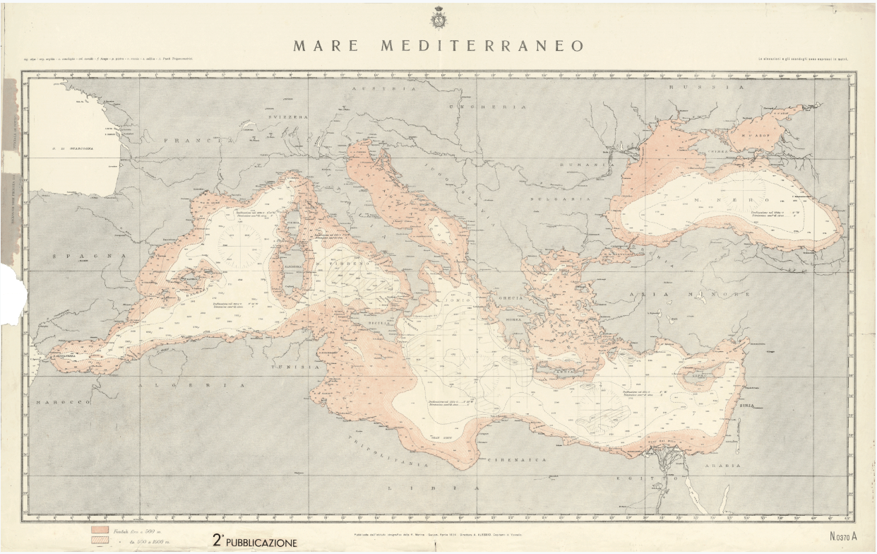
Membership
Nr. 22 Countries
Nr. 2 Observers
Nr. 4 Associates members
New member: Bulgaria, new IHO member, signatory of the statutes of the MBSHC
Observer States within the region are encouraged to sign the statutes of MBSHC (Albania and Lebanon)
Italian Hydrographic Institute, Mediterranean and Black Sea, 1924
MBSHC-21, Cádiz, Spain, 11-13 June 2019

Slide 3
Corporate Affairs
Relations with European Union
Greece is the focal point of IENWG
Participation to EU projects
Cooperation with IOC
Regional Early Warning system
Cooperation with CIESM
IHO-CIESM MoU umbrella
CIESM centenary – CIESM 42nd International Conference
MBSHC-21, Cádiz, Spain, 11-13 June 2019

Slide 4
C1-C2 decisions influencing MBSHC
IHO Resolution 2/1997
Paragraph 2 “Recognized by the Assembly, the RHCs …”
IRCC TORs endorsement
IHO future strategic plan
Seabed 2030 initiative presented
MBSHC-21, Cádiz, Spain, 11-13 June 2019

Slide 5
Hydrographic Services and Standards
HSSC-9: Ottawa, Canada , November 2017
HSSC-10: Rostock-Warnemünde, Germany , May 2018
HSSC-11: Cape Town, South Africa, May 2019
Nr. 6 HSSC priorities discussed
Maritime Services in context of e-navigation
MBSHC-21, Cádiz, Spain, 11-13 June 2019

Slide 6
Inter-regional coordination
IRCC-9: Suriname, June 2017
IRCC-10: Goa, India, June 2018
IRCC-11: Genova, June 2019
CATZOC
Region F coordination effort
Crowdsourced Bathymetry initiative
MSDI Ambassador
MBSHC-21, Cádiz, Spain, 11-13 June 2019

Slide 7
Perspectives
Improving charting coordination and cooperation in the Region
Enhance training, Competences and Standards usage (questionnaire outcomes)
Strengthening the technical capabilities of coastal States
Promote Capacity Building initiatives
Preparation of the 3rd session of the IHO Council and the 2nd session of the Assembly
MBSHC-21, Cádiz, Spain, 11-13 June 2019

Slide 8
Action requested of MBSHC
The MBSHC is invited to:
Note the report
Make additions as may be necessary
Take any other action deemed appropriate
MBSHC-21, Cádiz, Spain, 11-13 June 2019

